Slide 1
A NOVEL APPROACH TO ENVIRONMENTAL LITERACY
Ecology Project Presentation

Slide 2
DISCLAIMER
THIS IS:
A presentation explaining the motive behind the project
A presentation to show the reasons why the game was built the way it is now, and guide you through our thought process.
IT IS NOT:
Explaining game rules. (We already have a video tutorial and game manual ready for that, so check it out guys!!)

Slide 3
INCEPTION

Slide 4
Why this Project?
As part of this course, we were introduced to many new important concepts. These are the fundamentals to understanding our environment. But, we need to communicate this to other people as well
So we took the interesting idea of Carbon Footprint and that carbon emissions can be incentivised.
So, we need a project to make people understand what carbon currencies and carbon footprints are.

Slide 5
What type of project?
Most of the projects around this concept are technical and do not really target at teaching people.
We want to teach people about all the concepts mentioned in a fun way.
So, we decided to design a board game as part of this project.

Slide 6
OUR MAIN MOTIVE
FUN AND LEARNING
FOR BOTH
US AND THE PLAYERS OF THE GAME

Slide 7
Intended Outcome Sequence
Play
Enjoy the game with your friends and family
Educate
Educate those around you on these concepts and spread the message
04
01
03
Learn
Reflect upon your learnings from the game
Implement
Implement the concepts you learn in your daily lives
02

Slide 8
Core Beliefs
Judicious use of resources: In the current situation, it’s important to use our resources judiciously. We can’t close down factories and build sanctuaries without impacting the economy.
Entrepreneurship: Entrepreneurship is the way forward in business. Nowadays, children as young as 10-12 years are successfully running their ventures. It is important that they understand their environmental impacts to sustain the business.

Slide 9
The Design Philosophy
Realistic
Learning-Oriented
Gameplay
RPG Style
Aesthetic

Slide 10
Realistic approach
The industries are strategically located based on real world needs. For example, A steel factory would need to be located near coal mines for easy access.
The values in the game are representative of the actual carbon emissions in the industries.
We have integrated as many real-world ideas as possible without making the rules cumbersome.

Slide 11
Learning-Oriented Approach
Emphasis on critical ecology concepts: This game extensively covers the fundamentals of Carbon Footprints.
Promotion of Entrepreneurship
Understanding on how to reduce carbon emissions
Notes:
Basically if you teach Life Cycle Analysis and stuff to someone who does not even know what Carbon footprint is, it becomes overwhelming. Note that we aim to develop the sense of appreciation towards these concepts and equip them with some basics.

Slide 12
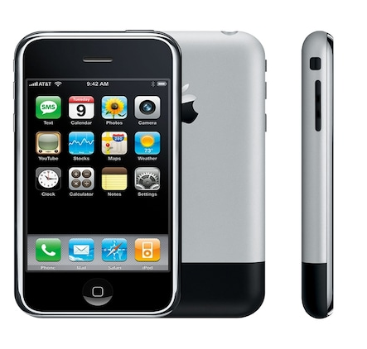

Aesthetics

Slide 13
RPG Gameplay (with a twist)
Role Playing Game: A place where players choose a character, and follow a structured decision-making pattern.
Here, players create their own story and way of playing. No choosing of characters. You create your own by your decisions
You can move around freely in the board in various ways. Not the traditional straight line.
The cheat codes in the game will have a price to pay, as what we are dealing with is the environment.

Slide 14
THE ELEMENTS OF THE GAME

Slide 15
What do we need to design for a board game?
We need four main things:
Currencies
The board itself
Industries/Objects which can be owned or bought
Most important, FUN

Slide 16
CURRENCIES

Slide 17
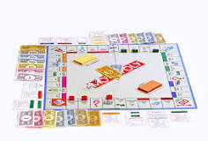
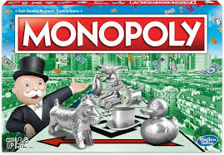
The Monopoly idea
Notes:
Invented to promote the concept of wealth generation
Flip formula: Encourages people to reduce carbon emissions
Is it enough to just have money replaced by CC?

Slide 18
Currencies
Money
Carbon Currency
Black Currency
White Currency
Notes:
check the colour
Green- Economic prosperity
Black- Smoke
White- Purity

Slide 19
Why do we need two carbon currencies?
The two notes are obtained by different means
White notes are a futuristic concept for when people will understand the value of carbon sinks
Rather than putting it as a reduction in black notes, it is better to explain it as being distinct

Slide 20
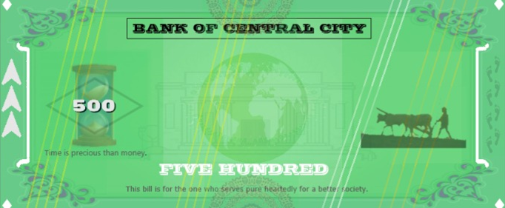
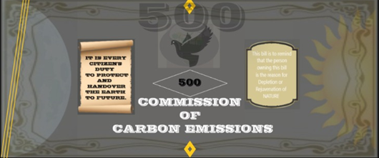
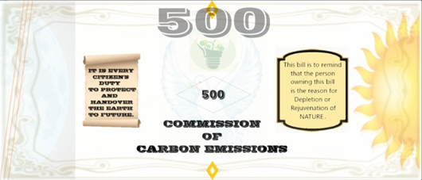
Notes:
Green represents economic prosperity (not for environment. Dont confuse).
Black represents smoke colour
White represents purity

Slide 21
THE BOARD

Slide 22
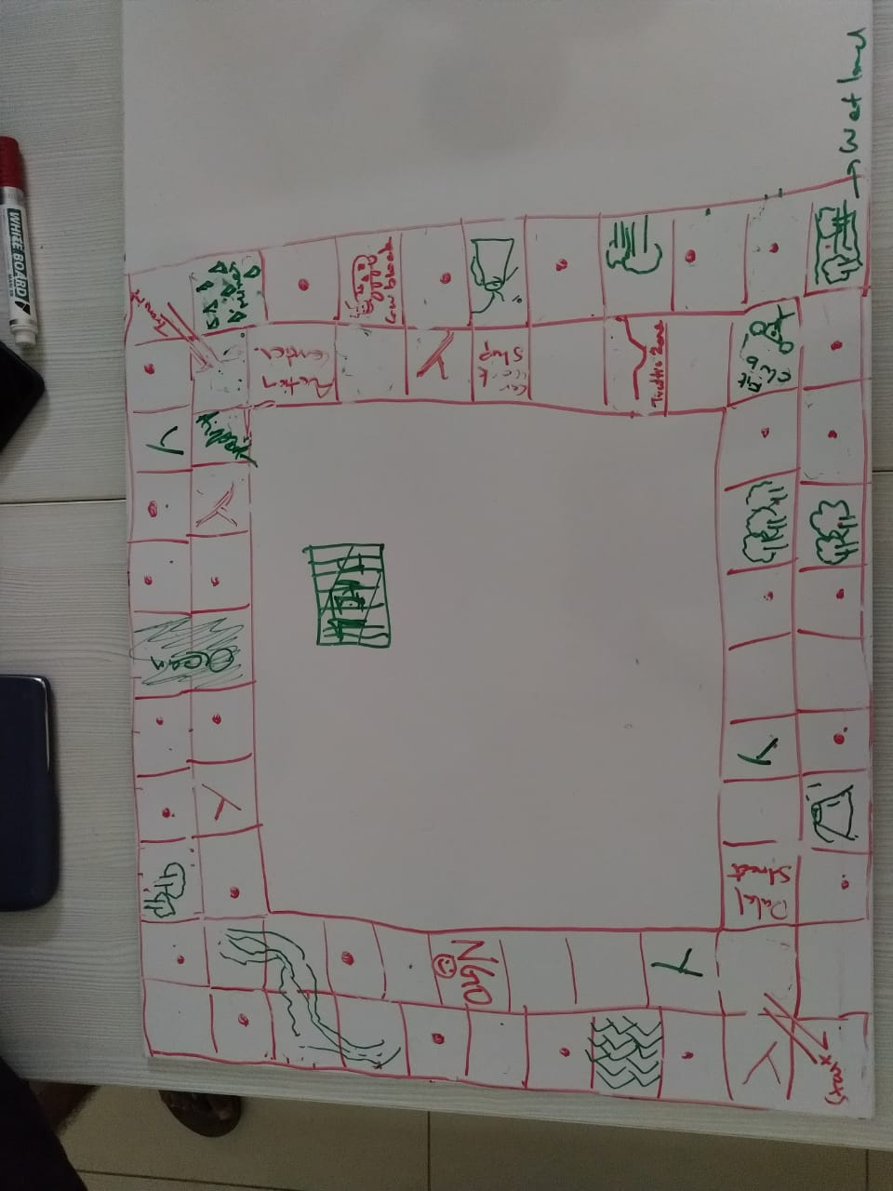
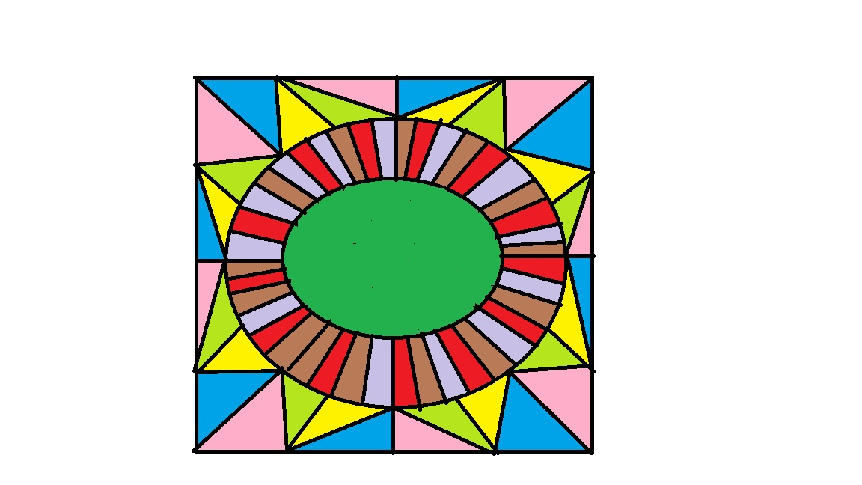
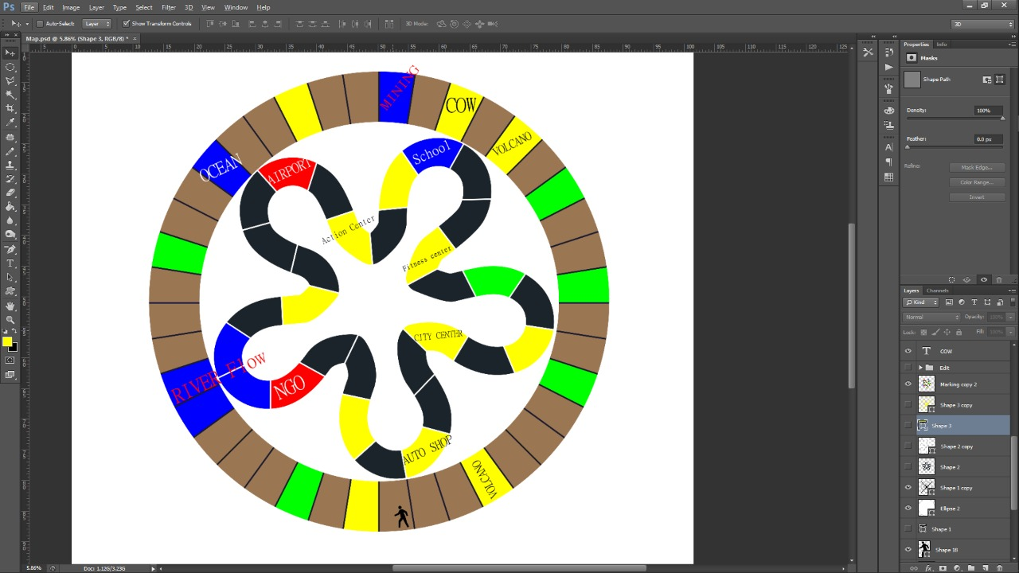
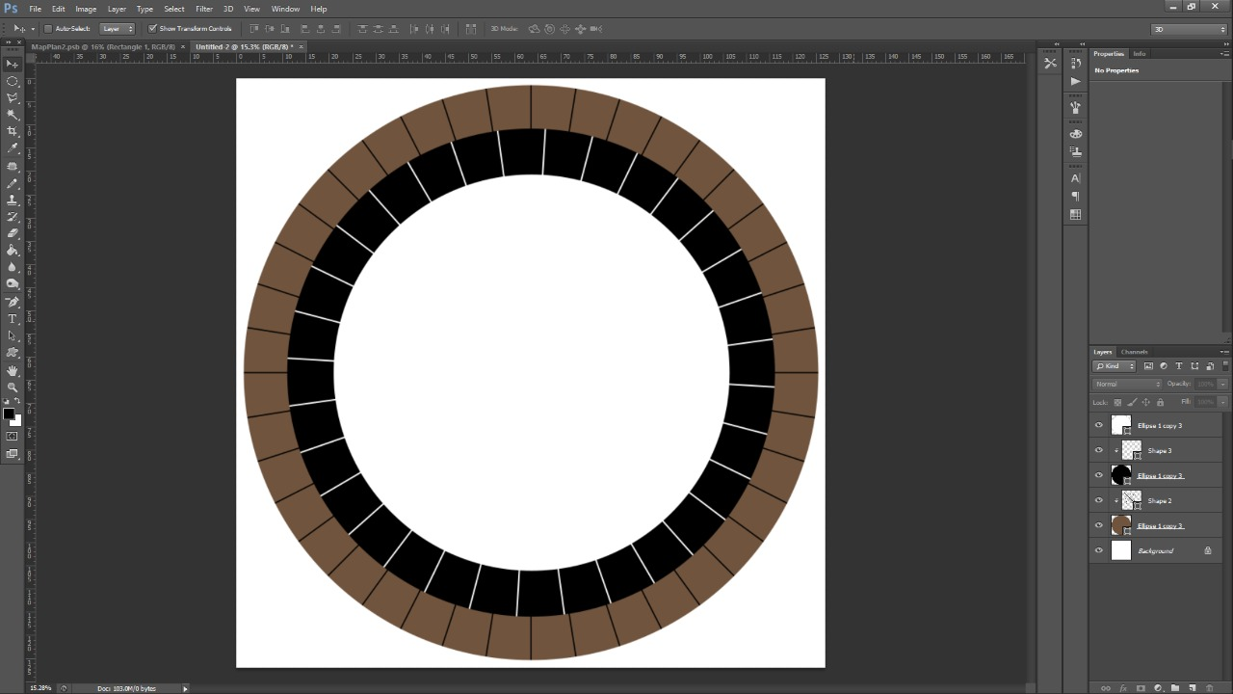
IDEAS AND MORE IDEAS:

Slide 23
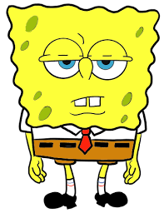
NORMAL BOARD GAMES:
SQUARE BOARDS.
LIKE REALLY SQUARE BOARDS.

Slide 24
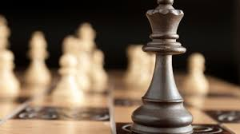
CHESS AND ENVIRONMENT:
Chess is a game which requires thinking and foresight. Isn’t life a game of chess too?
Well, we decided that our board should allow a player to move in any direction. Just as in real life.

Slide 25
Why the hexagon designs?
Hexagonal designs are prominent in nature, as in honeycombs.
Our game has allowed for hexagon tiles, as it allows users to move in more directions. Hexagonal tiles are pretty popular in online games.
It also suits our original intended design to accomodate 6 players. This board design can accomodate 6 people easily.
Notes:
iconic--- rectangular

Slide 26
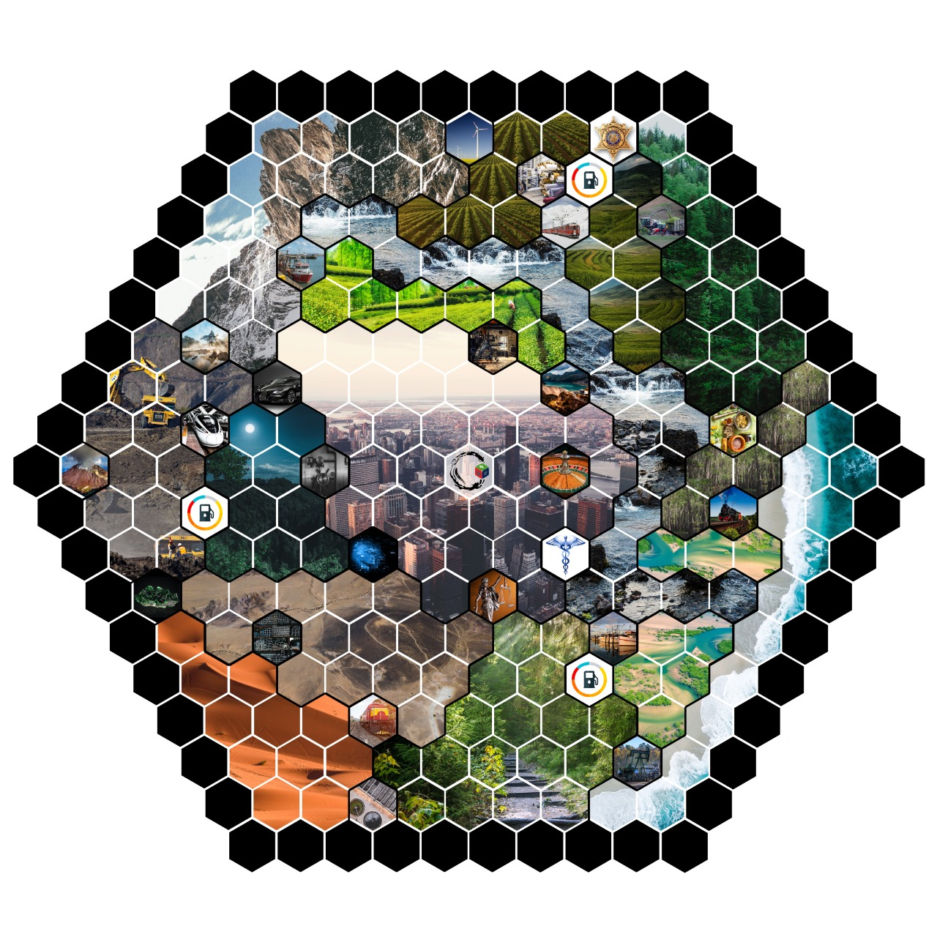
THE FINAL BOARD
Notes:
Ask Yashas for board.
We will be using dice for rolling . Unique pawn for each player will be given

Slide 27
INDUSTRIES AND REGIONS

Slide 28


Slide 29
Regions
Event Regions
Plain Regions
Open Regions
Existing Industries
Buildable Industries

Slide 30
Existing
Based on Location
Buildable
INDUSTRIES
Level 1
Based on Efficiency
Level 2
Level 3
Level 4
Level 5

Slide 31
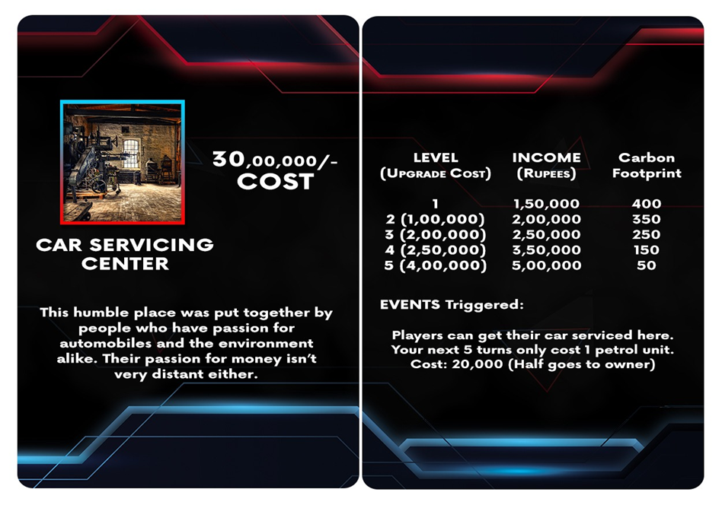
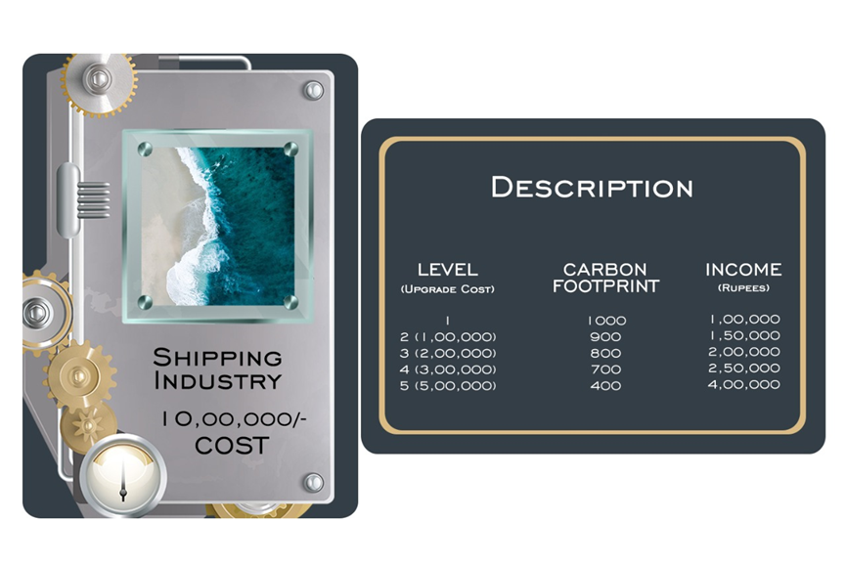
Existing Industry
Buildable Industry

Slide 32
COLOURFUL REGIONS= YOUR PLAYGROUNDS
Notes:
Ask Yashas for board.
We will be using dice for rolling . Unique pawn for each player will be given

Slide 33

A Tale of two factories
New Tech
Good maintenance
Lesser CO₂ emissions
More productivity
Tech not updated
Poor maintenance
More emissions
Less productivity

Slide 34
Existing
Based on Location
Buildable
INDUSTRIES
Level 1
Based on Efficiency
Level 2
Level 3
Level 4
Level 5

Slide 35
Event Regions
While conceiving the game, we thought the entrepreneurs could not progress their business empire without some essential services.
These include banks, courts, hospitals and Train stations.
Event regions add to the fun aspect, which will be discussed in detail in the upcoming section.

Slide 36
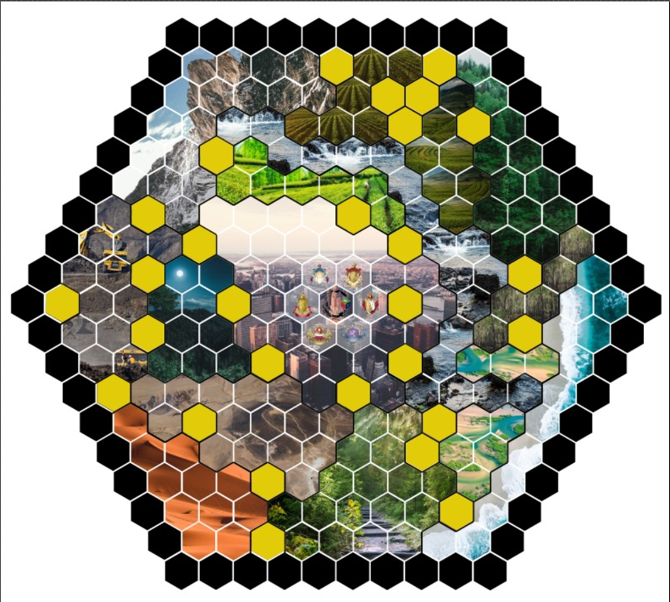

Slide 37
The Automobile Concepts.
Most of your travelling on the board will be on an automobile. For each tile you move, you will consume money and carbon footprints.
Like the BS standard that is followed in India, we have organized the automobiles also into various levels. This is for the following reasons:
Direct mirroring of real-life carbon monitoring
Limit on number of players in the later rounds

Slide 38
Additional Information
The price of buying a Buildable Industry is less than that of an Existing Industry. There are two reasons for this:
To give incentive to entrepreneurship
New industries do not have inventories, which form a major portion of the valuation
All information regarding the industries can be obtained from the Industry cards. This way the players need not keep referring the game manual for these details.

Slide 39
FUN ELEMENTS

Slide 40
chance.events=
fun x unpredictability
We have the event cards, which are drawn at random. It tests the abilities of a player to handle unexpected situations
The event cards will have to be shuffled at random .

Slide 41
Event Cards and the Reasoning:
Our event cards are based on real life events.
Each industry has its own event triggers. The event triggers are closely related to real world to teach people about what are the possible consequences of building industries.
Unlike in other board games, events in our board game have an environmental background to their meaning

Slide 42
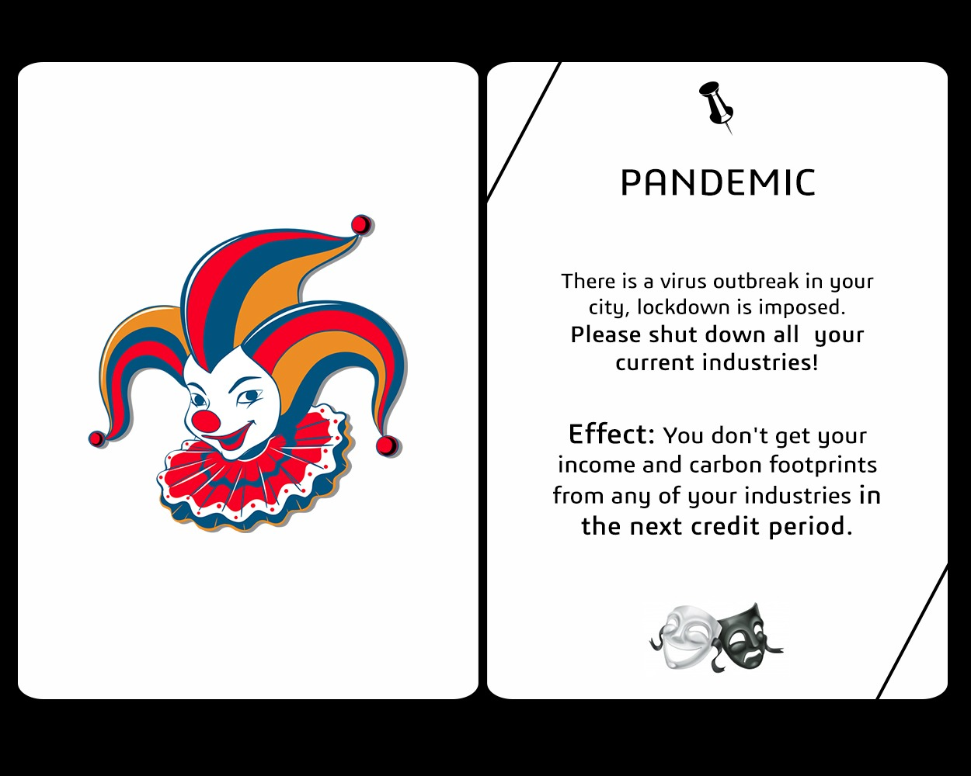
AN EXAMPLE.
THE PANDEMIC
EVENT
Life is all about trade offs isn’t it?
Notes:
This event card teaches people that even though your industries are shut down and the income is stopped, there are positives to it. In this case, emissions drastically reduce to zero.

Slide 43
For more information, please refer:
Group Folder ( https://drive.google.com/drive/u/1/folders/1Au1Bc4c4n1iFLII179iyw5Pszth6QQN7)

Slide 44
The Way Forward...
Physical prototype
We initially intended to present a physical board game with the dice and cards along with it. Due to the pandemic situation, this plan has been postponed.
Reconfigure Material design
With inputs from our players, we will modify the gameplay. Along with it, sustainable materials for manufacturing the board will be seeked.
Mobile and Web Applications
Since people play games on their devices more than ever, we plan to develop Mobile and Web apps with multiplayer option.
Extensive Testing
With the prototype ready, we will test the gameplay with varied age groups.
Release the final version
With testing and reconfiguring done, we will release the end product with help from a manufacturing partner.

Slide 45
THE TEAM

Slide 46
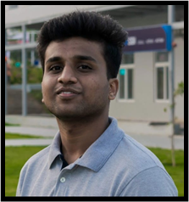

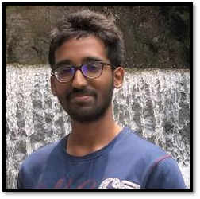
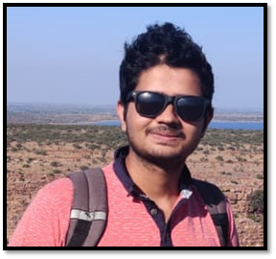

The Research and Development Cell
We make rules and then we break them!

Slide 47


The Design Cell
We got the maximum workload for minimum members

Slide 48

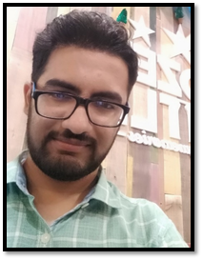


The Content and Marketing Cell
We can’t do anything until the other two finish their work

Slide 49
WHAT WE LEARNT

Slide 50
WHAT WE LEARNT:
Teamwork
For us, we learnt a lot about teamwork and consensus. All the decisions we took were after we held team meetings and took votes. Democracy in action!!
Dedication and Passion
We are passionate about our product and didn’t stop until we were satisfied with our work.
Division of Labour
We divided our team well, which ultimately led to more productivity.

Slide 51
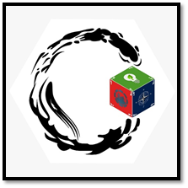

Slide 52


